Slide 1

Bitcoin Forcasting
Notes:
1. Table of contents
2. Introduction
3. Our company
4. Our team
5. Problem
6. Them vs. us
7. Solution
8. SWOT analysis
9. Product overview
10. Our plans
11. Product demo
12. Traction
13. Case study
14. Reviews
15. Awards
16. Market size
17. Target
18. Competitors
19. Business model
20. Timing
21. Predicted growth
22. Investment

Slide 2
Table of Contents
01
02
03
04
Introduction & Problem statmment
Dataset & EDA
Methodology
Conclusion

Slide 3

Introduction
$40 billion worth of cryptocurrencies are traded every day.
They are among the most popular assets for speculation and investment,
wildly volatile and Fast-fluctuating prices

Slide 4
Introduction
Cryptocurrancy & Stock Market
ML in Time series Analysis

Slide 5
02
Dataset &EDA

Slide 6
Description
Source
Bitcoin Types ( 14 Assets)
Shape of data :
24236806 Records / 1956960 for bitcoin
10 columns (Features)

Slide 7
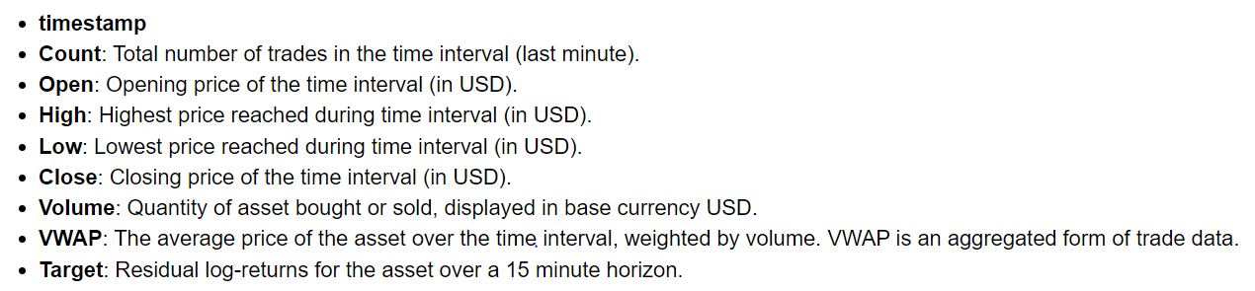
Features
Bitcoin Begins :
from : 2018-01-01 to: 2021-09-21

Slide 8
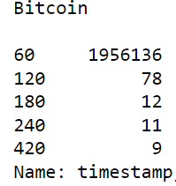
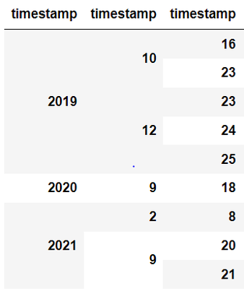
Pre-processing
Padding
Target Null Pattern , filled with Previous

Slide 9
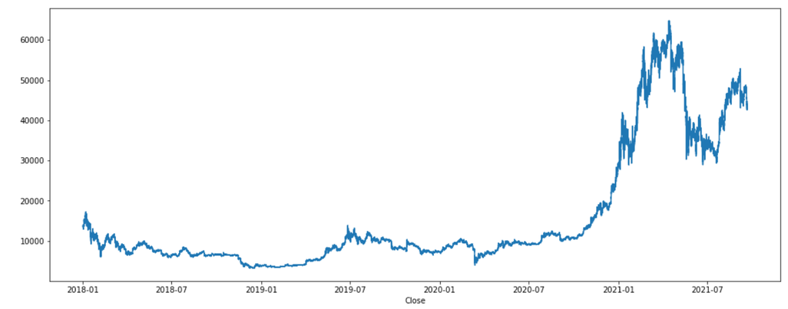
EDA ( Close)

Slide 10
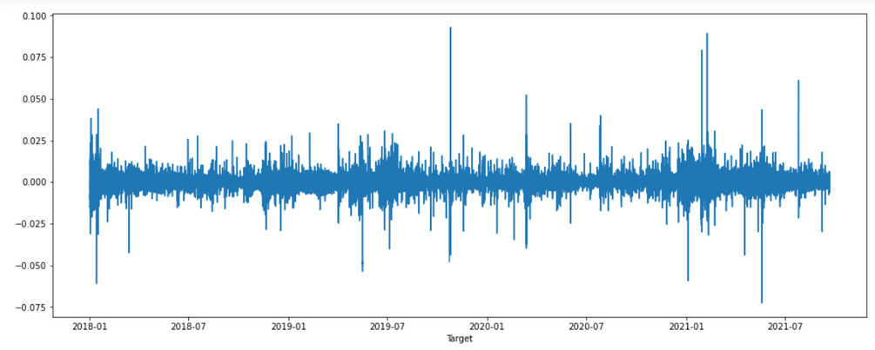
EDA (Return)

Slide 11
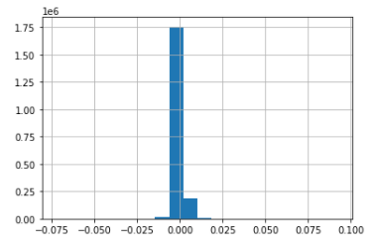
EDA
Return

Slide 12
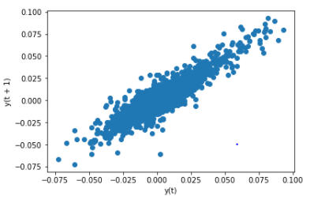
EDA
Target Lag Plot

Slide 13
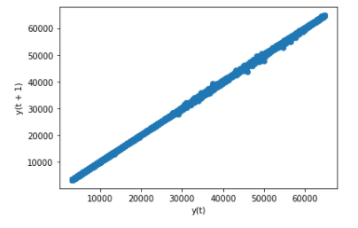
EDA
Close Lag Plot

Slide 14
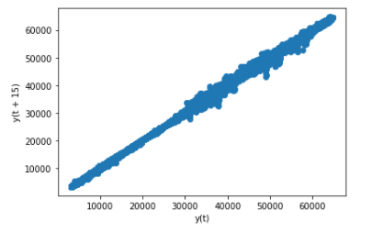
EDA
Close Lag Plot ( 15 shifts)

Slide 15
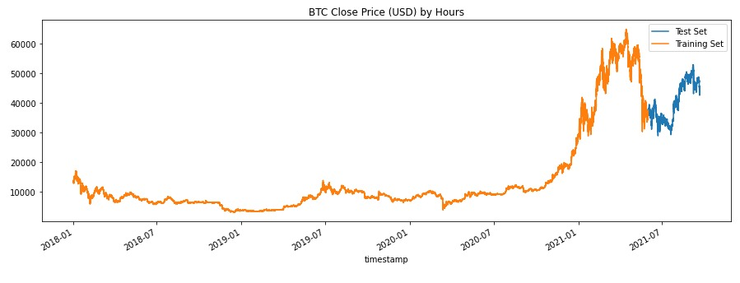
EDA

Slide 16
03
Methodology

Slide 17
LSTM
Cross validation
128 Units for LSTM Layer
Use Sigmoid activation function
Drop out layer
50 Epochs
batch size = 250
X = Close ( t )
Y = Close ( t + 1 )

Slide 18
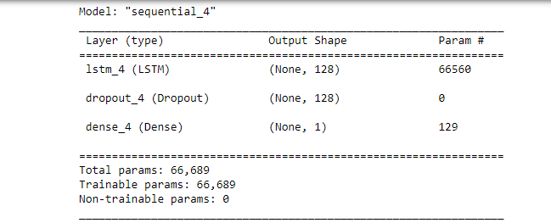
LSTM

Slide 19
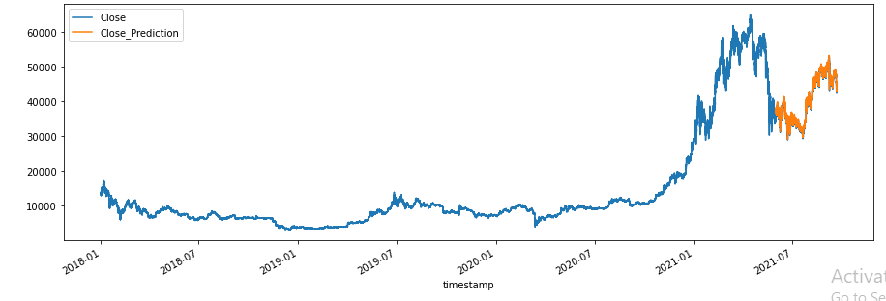
LSTM (prediction)

Slide 20
LSTM (Result)
Mean squared error = 107273.68
Mean absolute error = 310.72
correlation coefficient = 1.0

Slide 21
XGBoost
Extreme Gradient Boosting
Regularization
Big ML algorithm Can handle big data.
XGBoost have many Hyperparameters
XGBoost using sequential method
Sequential method take the results from the previous tree and improve it in the next tree.

Slide 22
XGBoost Hyperparameters
Objective: the method which the model use
Softmax : Classification
SoftProb: Weighted Classification
Reg , linear: Linear Regression ( Used with our datas).
ETA: Learning Rate of the model ( Default 0.3)
Alpha: Control Regularization (L1)

Slide 23
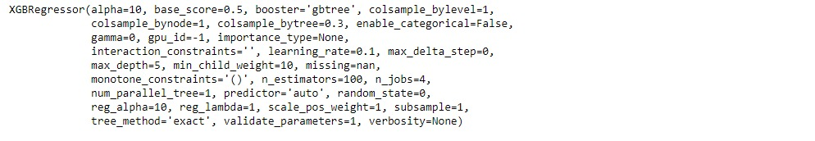
XGBoost Hyperparameters
Max_Depth: the Depth of the tree will be made.
min_child_weight: control the overfitting.
Booster: GB tree.

Slide 24
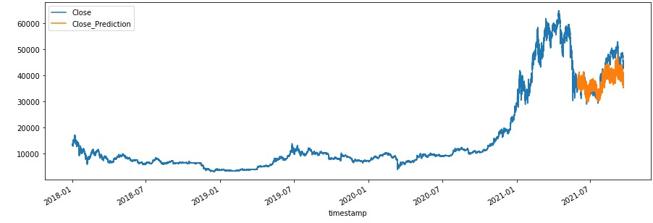
XGBoost

Slide 25
KNN
Mean of the most nearest values.
Mean squared error = 725.56.
Mean absolute error = 18.37.
correlation coefficient = 1.0
7 Neighbours.

Slide 26
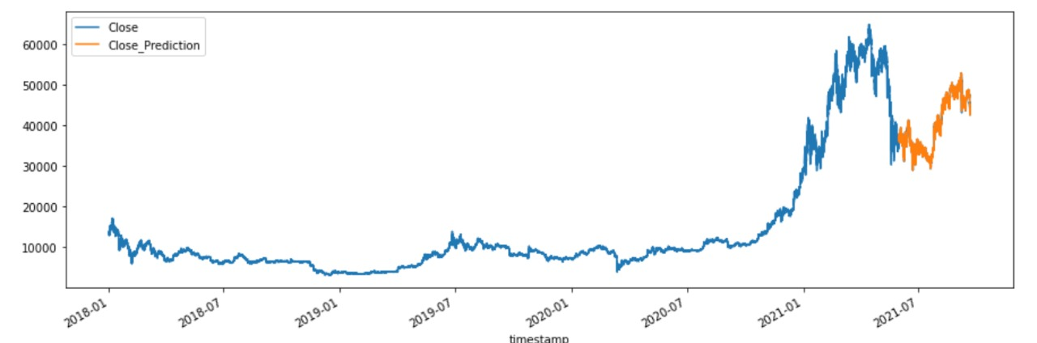
KNN

Slide 27
Evaluation metric
MSE
Correlation coefficient

Slide 28
04
Conclusion

Slide 29
Result Summary
Having created XGBRegressor, KNN, RNN(LSTM) Models (trained on data from (1/1/2018 until 1/1/2021) of the dataset and tested the models on data from 1/1/2021 to 1/09/2021
The result of the prediction on closing :
XGBRegressor correlation coefficient 0.88
KNN correlation coefficient 1
RNN(LSTM) correlation coefficient 1
Future work: Prediction on a 15 minute time interval

